Slide 1
running time

Slide 2
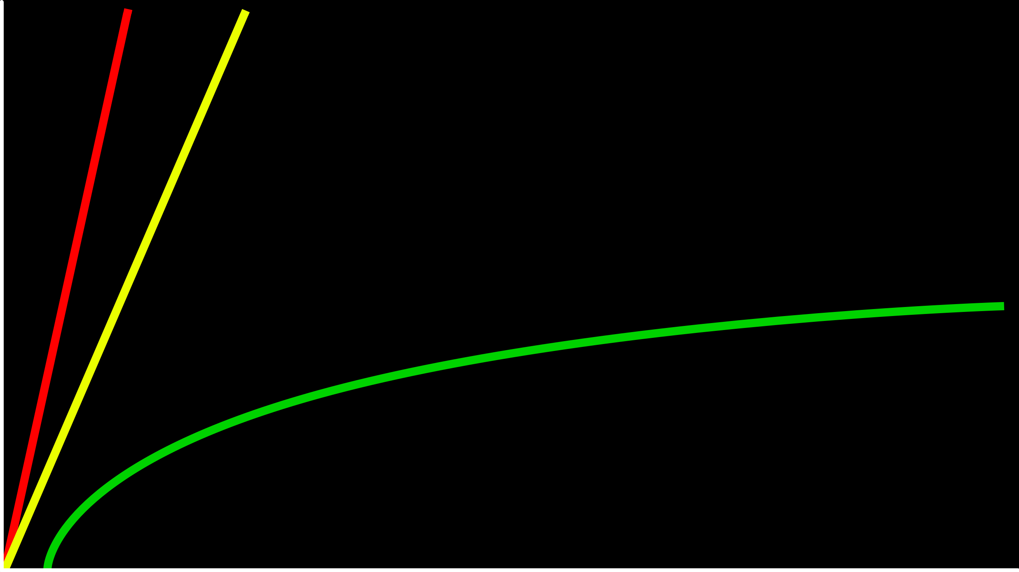
time to solve
size of problem

Slide 3
O(n/2)
O(n)
time to solve
O(log₂n)
size of problem

Slide 4
O(n)
O(n/2)
time to solve
O(log₂n)
size of problem

Slide 5
O(n)
O(n)
time to solve
O(log₂n)
size of problem

Slide 6
O(n)
O(n)
time to solve
O(log n)
size of problem

Slide 7
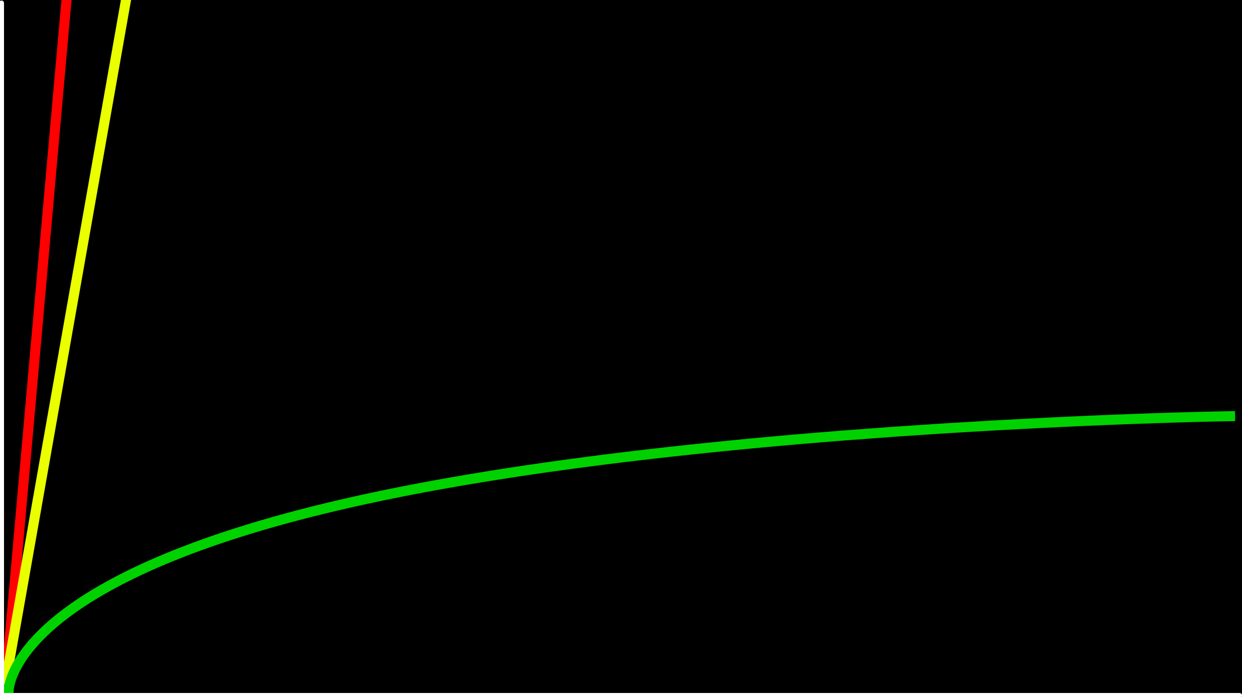
O(n)
time to solve
O(log n)
size of problem

Slide 8
O – Big O

Slide 9
O(n²)
O(n log n)
O(n)
O(log n) binary searc
O(1)

Slide 10
O(n²)
O(n log n)
O(n) linear search
O(log n)
O(1)

Slide 11
O(n²)
O(n log n)
O(n) linear search
O(log n) binary search
O(1)

Slide 12
Ω

Slide 13
Ω(n²)
Ω(n log n)
Ω(n)
Ω(log n)
Ω(1)

Slide 14
Ω(n²)
Ω(n log n)
Ω(n)
Ω(log n)
Ω(1) linear search

Slide 15
Ω(n²)
Ω(n log n)
Ω(n)
Ω(log n)
Ω(1) linear search, binary search

Slide 16
Θ

Slide 17
Θ(n²)
Θ(n log n)
Θ(n)
Θ(log n)
Θ(1)

